Slide 1
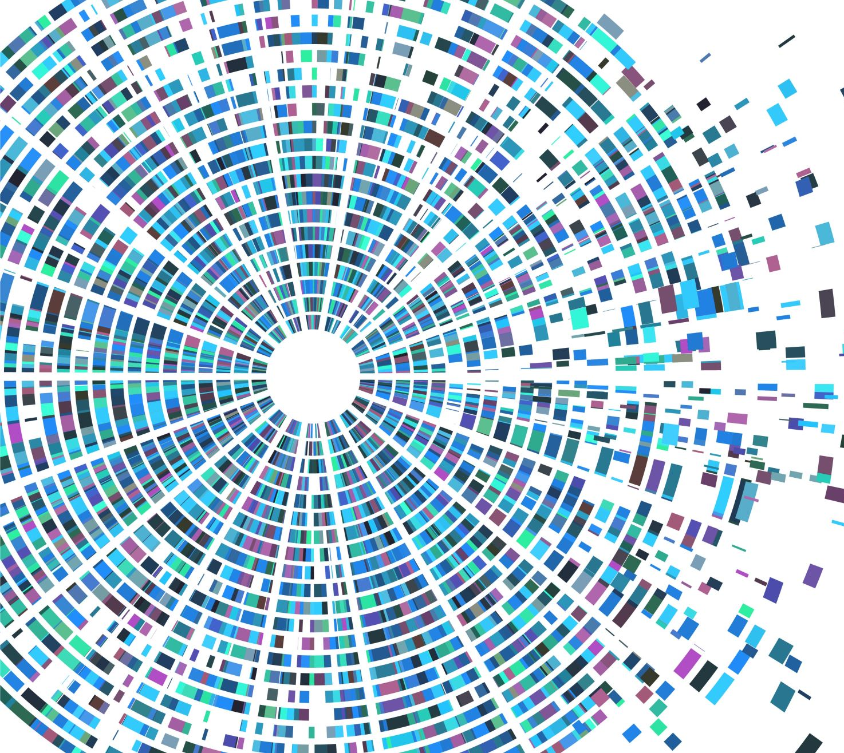
Multilabels Classification of Podcast Genres
An Experiment with Multimodal Neural Networks

Slide 2

Podcasts
Podcasts are an emerging medium on the internet and the number of shows is growing exponentially over the years
They provide huge amounts of data for many different tasks (e.g. audio transcription)
Streaming services (e.g. Spotify, Apple Music) usually classify shows on the basis of manual annotations and use those labels to suggest new contents to their users
Is it possible to automatically classify podcasts according to the metadata available?

Slide 3
Project workflow
Extract and prepare the data
1
Find the right architecture for each type of data (text and images)
2
Build and train a multimodal network
3
Evaluate the results
4

Slide 4
Dataset
Lack of existing dataset focusing on this kind of task (e.g. Spotify dataset is meant for audio transcription)
Extracted a dataset from Apple Music using their APIs, including nearly 30000 different shows
Each show has metadata regarding title, description, cover image, authors and primary genre

Slide 5
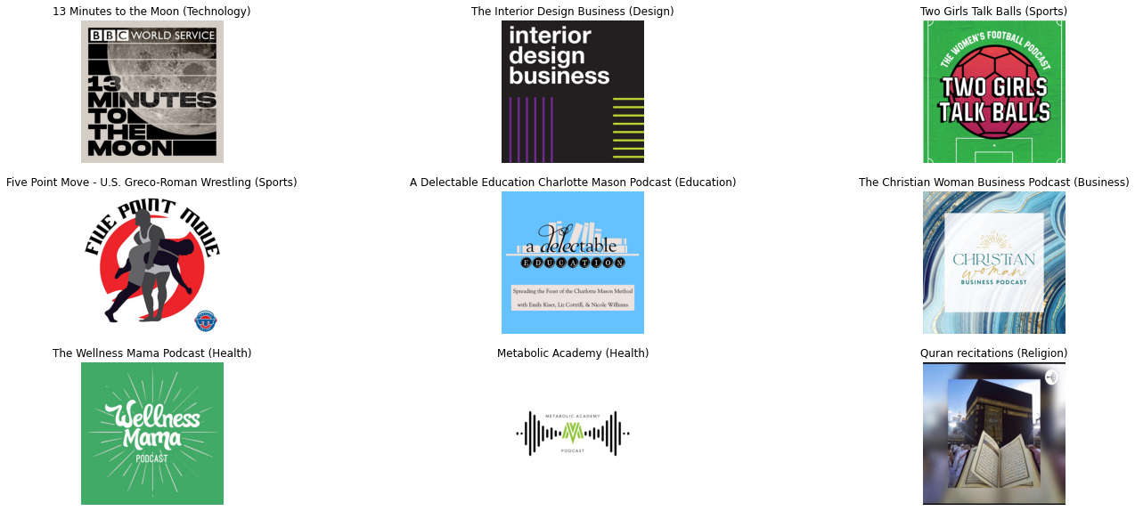
Dataset: cover images

Slide 6
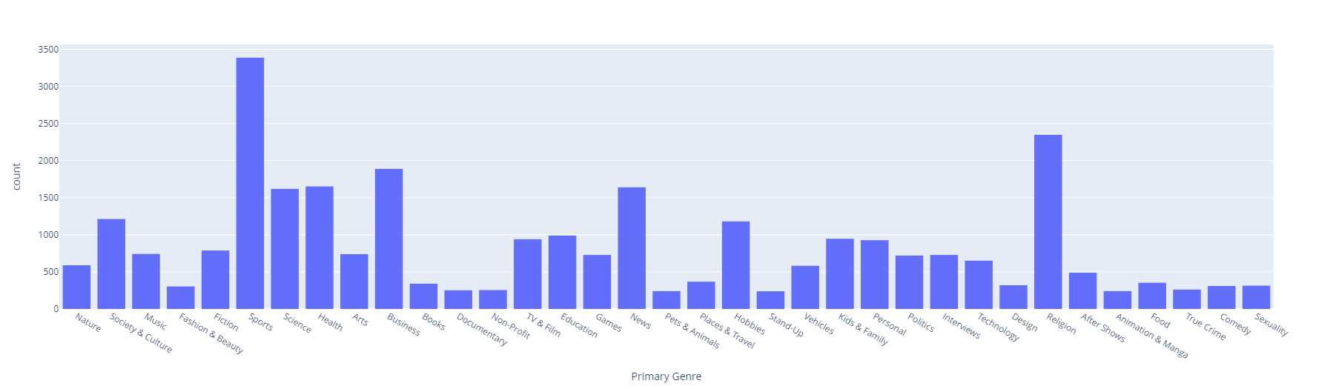
Dataset: genres
Originally 110 different genres with many overlaps
After pre-processing only 35 different genres with a rather unbalanced distribution

Slide 7
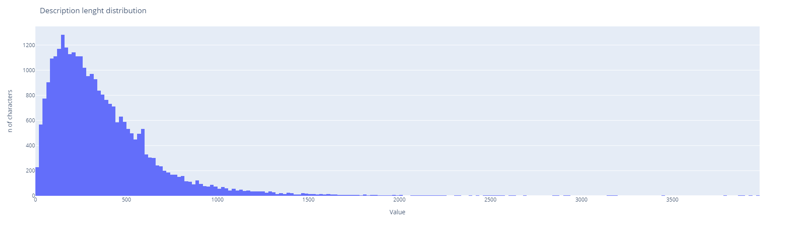
Dataset: descriptions
Title: Two Girls Talk Balls
Description: «An alternative take on Women's Football. Covering the WSL, NWSL, Euro 2022 and Women's Champions League; Charlotte and Tamsin bring a refreshing voice with debate, banter and highlights from the best of the Women's Game. Proudly sponsored by FotMob”

Slide 8
DNN: images
DNN can learn how to filter (parts of) an image to extract relevant features (Convolutional Neural Network)
Images are coded as a numerical matrix (height x width x channels)
Each image in the dataset is in JPEG format and has a shape of 600 x 600 x 3 (RGB)
Instead of building from scratch a CNN, better performances are achieved use a pre-trained architecture (transfer learning)

Slide 9
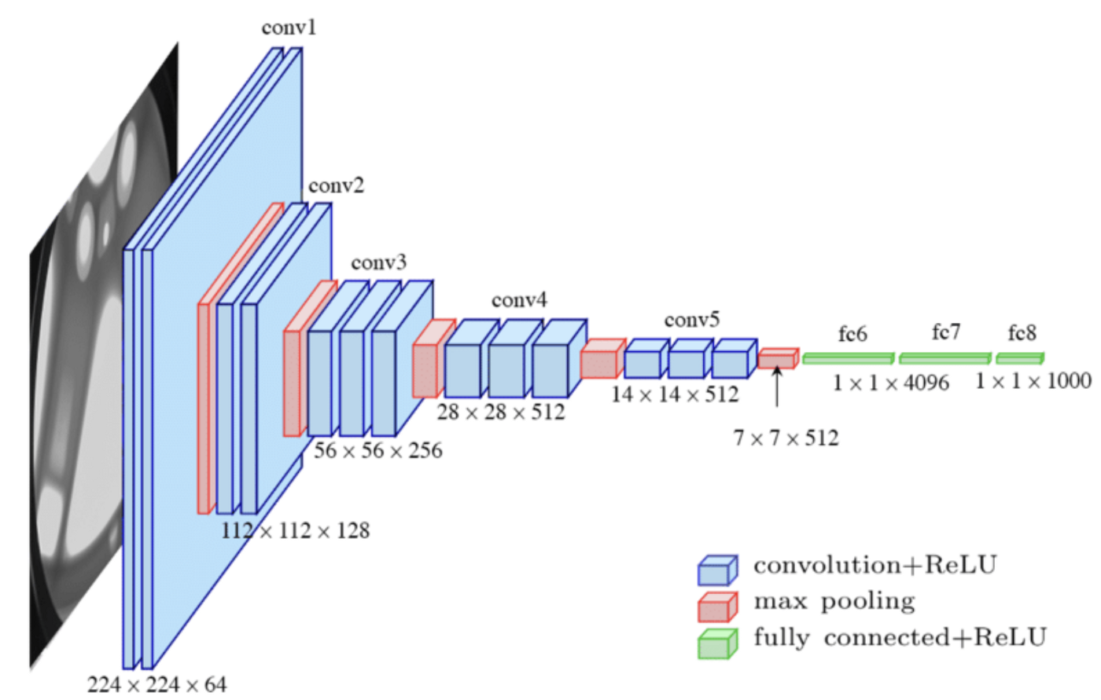
VGG16
Large architecture trained on millions of images (ImageNet dataset)
It can be used for different tasks without re-training thanks to transfer learning
Stack of convolutional layers and max pooling using ReLU as activation function

Slide 10
VGG16
Cut the last layer (classifier head) and replace it with a dense layer with a neuron for each label (35)
Reshape images to 224 x 224 size and convert them from RGB to BGR (automatically pre-processed by Keras)
Use data augmentation to create artificially additional samples for training (random flip and random rotation)

Slide 11
DNN: descriptions
Textual data has to be converted into numerical arrays (assigning each token to a numerical ID and passing it to an embedding layer)
Text is understood as a sequence problem, thus RNN are commonly used for text classification and language modelling
In order to be fed to RNNs, text must be normalized: tokenization, stop-words elimination, lemmatisation

Slide 12
DNN for text: GRU
GRU is a special kind of LSTM, faster to train and (usually) more efficient
Standard RNNs have problems with long sequences, which is rather usual in textual data (vanishing gradient problem)
LSTM are able to solve this problem by implementing a form of long-term memory

Slide 13

Brief introduction to LSTM

Slide 14
Brief introduction to LSTM
Cell state
Gates

Slide 15
Brief introduction to LSTM
Forget gate layer

Slide 16
Brief introduction to LSTM
New information to add to the state cell

Slide 17
Brief introduction to LSTM
Input gate layer

Slide 18
Brief introduction to LSTM
vector of new candidate values that could be added to the cell state

Slide 19
Brief introduction to LSTM
Filters the output of the cell state and serves as hidden state for next step

Slide 20

GRU
Simpler than normal LSTM
Combines forget and input gate into a single «update layer»
Merges cell states and hidden states into one
Reset gate decides whether the previous cell is important or not

Slide 21
Multimodal network

Slide 22
Data fusion
It can mix information to extract more knowledge and have a better form of abstraction of the problem
Framework in which multiple data source are mixed to make them more useful for a specific application
Particularly useful in robotics or computer vision in general
The goal is to improve the system performances both in terms of accuracy and robustness

Slide 23
Late vs early fusion
Late: it fuses the results of two or more different computational streams that work in parallel (this case)
In the literature the distinction between early and late fusion depends on the position of the fusion process
Early: it merges data sources at the beginning of the process to create a joint representation of the data

Slide 24
Keras implementation
For VGG16 and the GRU model the Generator class was used to feed the network batches of data without saturating memory
The project was implemented with Keras high level APIs, splitting the original dataset into training, validation and test sets
The multimodal network required to build a custom generator in order to feed mixed type of data to the network
Training was performed on Google Colab and Amazon Sagemaker Studio Lab (Tesla K80 vs Tesla T4)
It relied on standard hyperparameters (Adam optimizer, batch size of 32, categorical cross-entropy as loss function) and early-stopping to avoid excessive overfitting

Slide 25
The multimodal network (VGG16 + GRU)
Text input + embedding
GRU (128)
GRU (128)
Dense (35, relu)
Dropout
Dropout
Dense (1024, relu)
Dense (35, softmax)
Dropout
Data augmentation + VGG16 pre-processing
Images input 224 x 224 x 3
VGG16
Dense (512, relu)
Dense (35, relu)
Flatten

Slide 26
Results

Slide 27
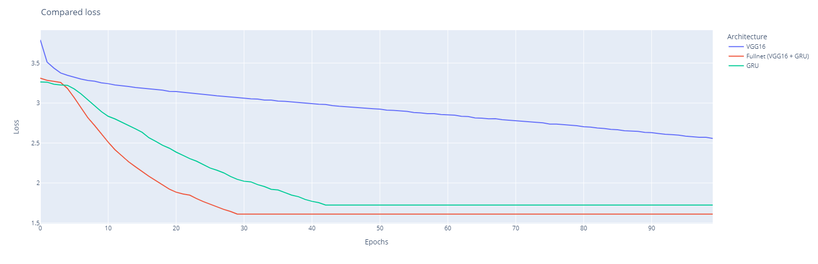
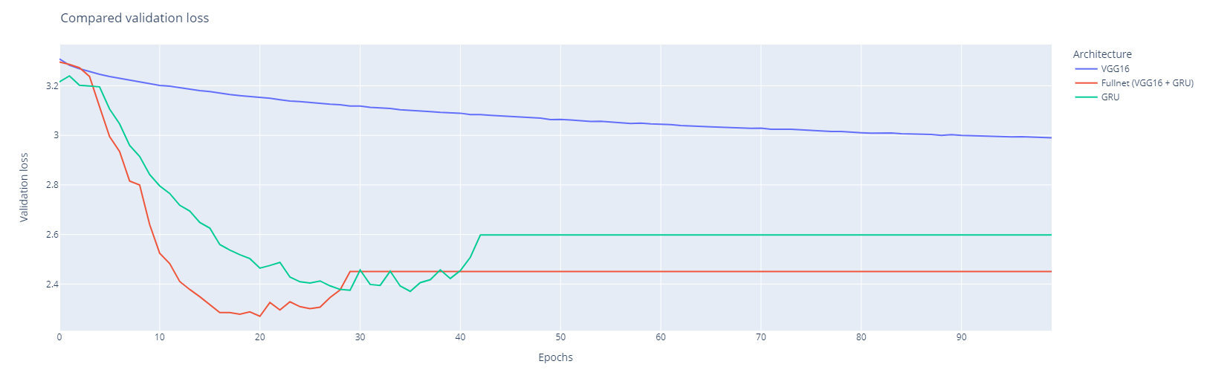
Compared losses
VGG16 required a much slower learning rate to gain adequate performances
GRU and multimodal network are much faster and able to reach lower loss both in training and validation
Early stopping prevents excessive overfitting

Slide 28
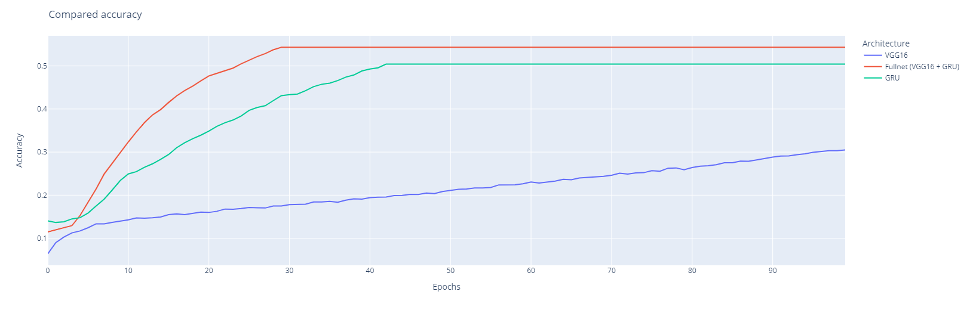
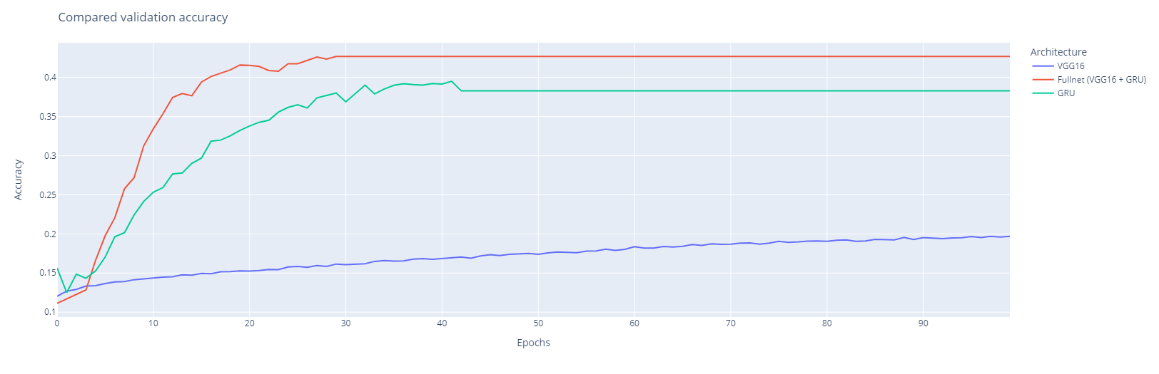
Compared accuracy
VGG16 learns very slowly over time
GRU and multimodal network are much faster and able to reach lower loss both in training and validation
Early stopping prevents excessive overfitting

Slide 29
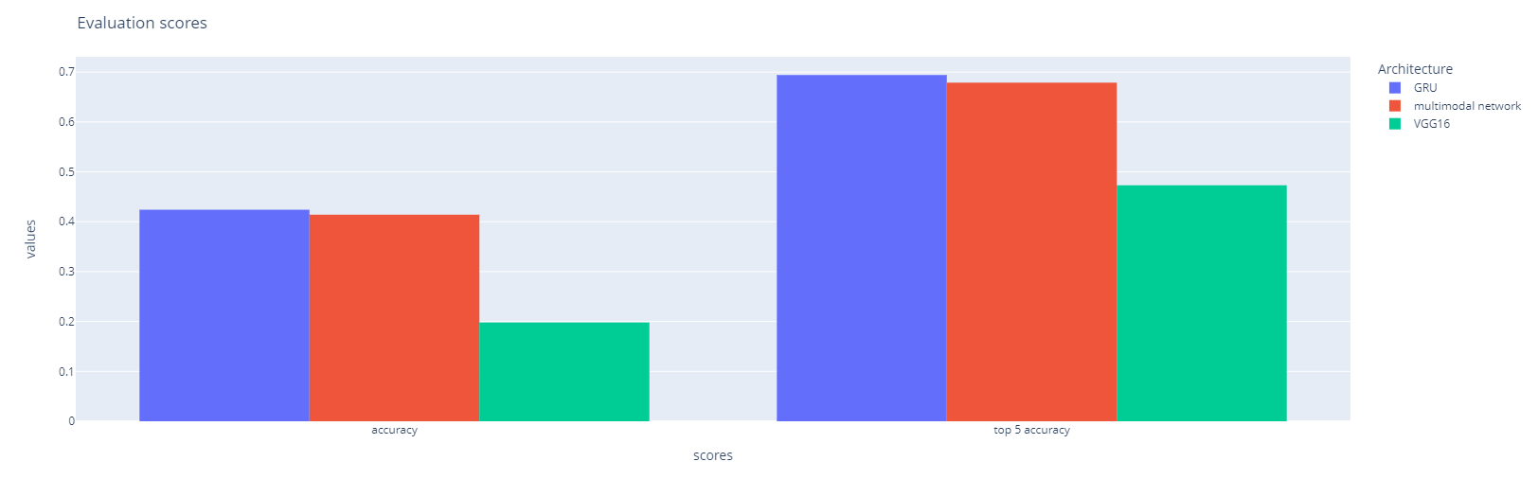
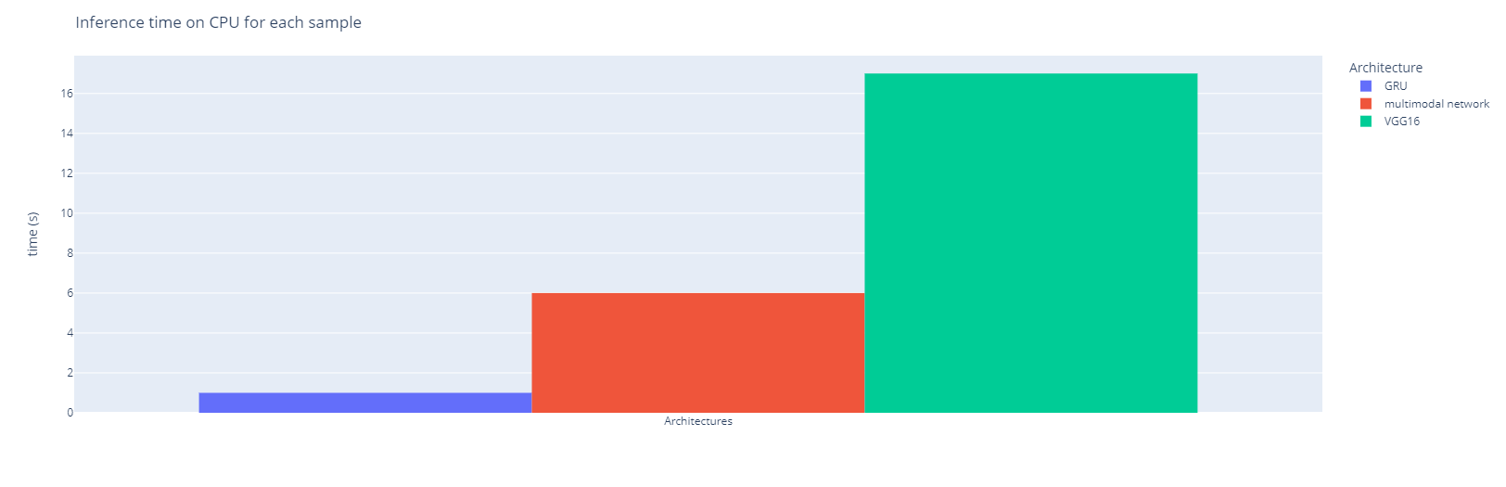
Evaluation metrics on testing set
GRU is slightly more accurate on the testing set
Inference time increase for the multimodal network, but not as dramatically expected looking at how VGG16 performs on its own
If we consider top 5 accuracy the difference between GRU/multimodal and VGG16 is less significant

Slide 30
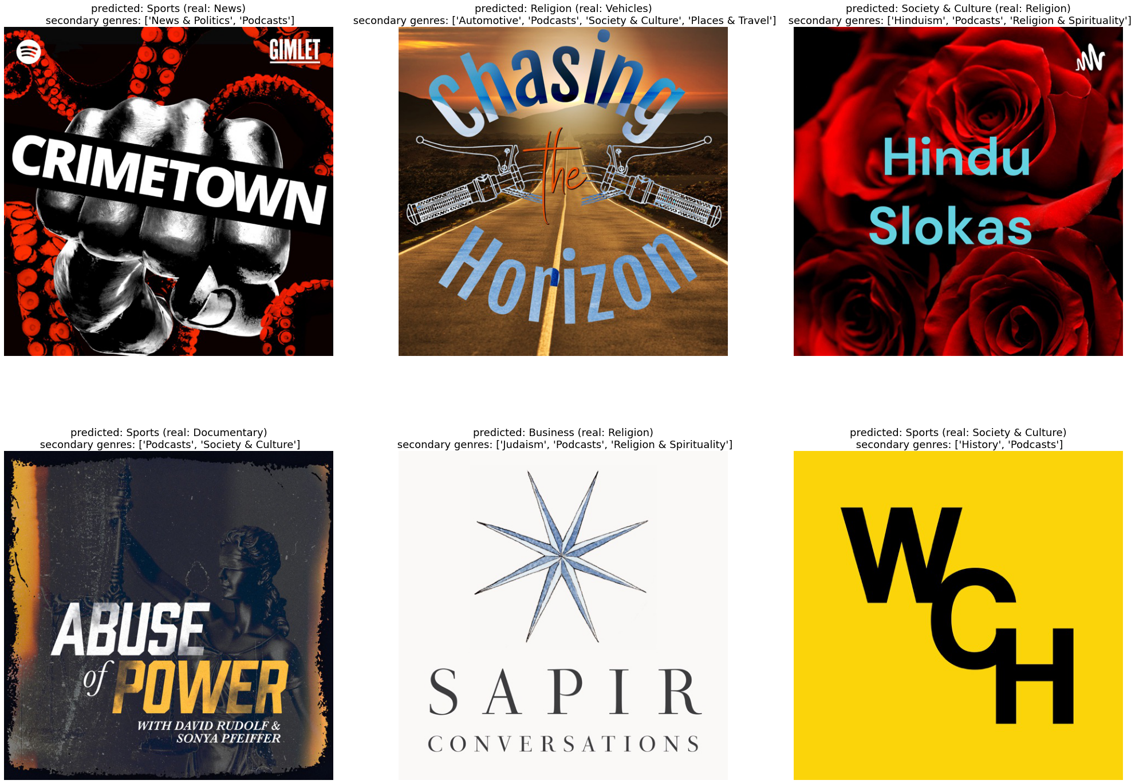
Predictions: VGG16

Slide 31
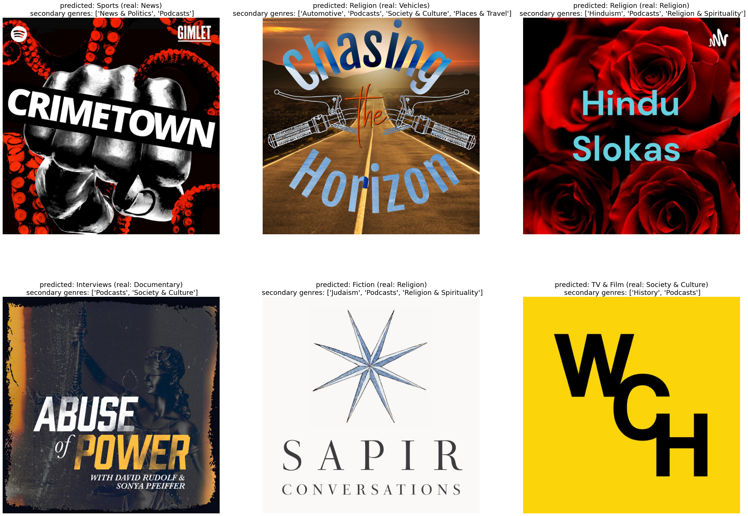
Predictions: GRU

Slide 32

Predictions: multimodal network

Slide 33
Balance vs unbalanced metadata
«Chasing the Horizon is a podcast by, about and for motorcyclists. We talk to motorcycle industry figures, technical experts and riders just like you no matter what bike they love to ride. Please sign up on the mailing list at http://tinyletter.com/chasingthehorizon and subscribe in popular podcast apps or listen to every episode at http://chasingthehorizon.us»
VGG16: Religion
GRU: Religion Multimodal: Vehicles
VGG16: Society & Culture
GRU: Religion Multimodal: Vehicles
«Hindu slokas»

Slide 34
Conclusions
The multimodal model converges faster (in terms of epochs) during training and it tends to have better accuracy
However, the GRU model performs a little better on the testing set: this might be due to the fact that the dataset is largely unbalanced and so is the testing set
The multimodal approach seems to help in cases in which the two features are likely mixed, but it might lead to mistakes in unbalanced cases (e.g. less text and confusing image)
Labels were manually and arbitrarily aggregated; we might get better results depending on how genres were merged
Further experiments with larger and more balanced dataset could improved performances

Slide 35
Bibliography
Miller, Stuart J., et al, «Multi-Modal Classification Using Images and Text», SMU Data Science Review 3.3 (2020): 6.
Gadzicki, Konrad, et al., «Early vs late fusion in multimodal convolutional neural networks», 2020 IEEE 23rd International Conference on Information Fusion (FUSION), IEEE, 2020.
Li, Jonathan, Di Sun, and Tongxin Cai, «Genre Classification via Album Cover».
Ofli, Ferda, Firoj Alam, and Muhammad Imran, «Analysis of social media data using multimodal deep learning for disaster response», arXiv preprint arXiv:2004.11838 (2020).

Slide 36
Bibliography
Yin, Wenpeng, et al., «Comparative study of CNN and RNN for natural language processing», arXiv preprint arXiv:1702.01923 (2017).
Ahmed, Eman, and Mohamed Moustafa, «House price estimation from visual and textual features», arXiv preprint arXiv:1609.08399 (2016).
Nawaz, Shah, et al., «Are these birds similar: Learning branched networks for fine-grained representations», 2019 International Conference on Image and Vision Computing New Zealand (IVCNZ), IEEE, 2019.

